Slide 1
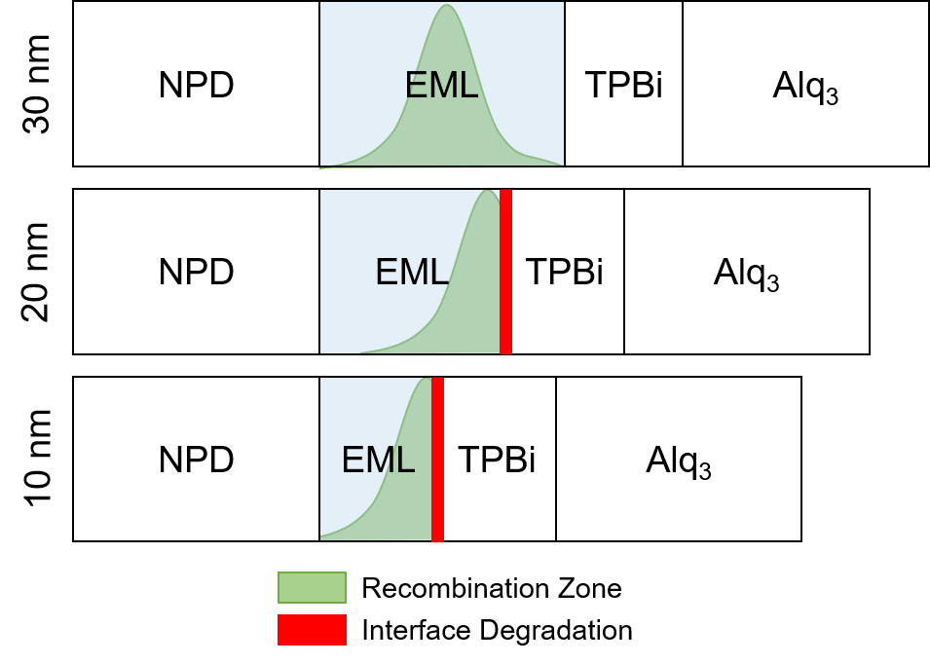

Slide 2
30 nm Sensitized
Unquenched reference is from a different growth
Sweeps and EQE are identical
Recombination zone is moved away from the interfaces

Slide 3
20 nm Sensitized
Loss of over >1% EQE (~10% of total) when quenched at ETL
Unquenched reference is from a different growth
Recombination zone is shifted to ETL side
Isn’t strongly peaked at side (only 10% emission lost)

Slide 4
10 nm
Reduction on both sides
More intense on the ETL side as expected
IV shapes change, indicating this is not comparable
Regrowing devices with sensitizer doped into neighboring layers rather than EML

Slide 6
a.
b.
c.
d.

